Slide 1
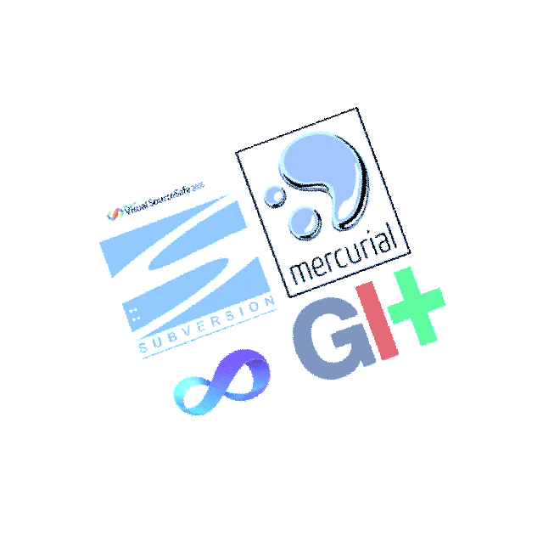
Version Control System &Git
        - Randheer Katiyar

Slide 2

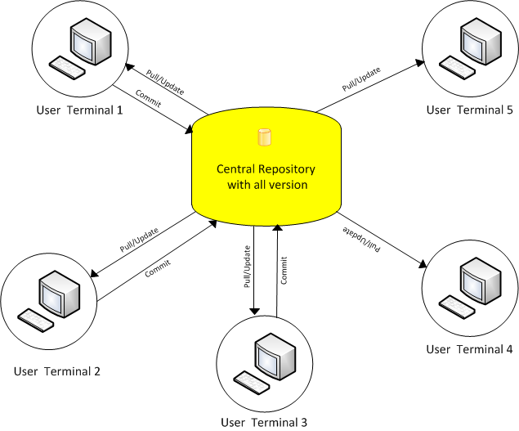
Repository of file, often the files for the source code of computer program with monitored access.
Every single modification made into the file can be tracked along with who made this changes and when.
VCS is essential for the Distributed and for collaborative development

Slide 3

On the basis of various features Version control system has mainly two types -
  Centralized Version Control System (CSVs)
  Distributed Version Control System (DVCs)

Slide 4
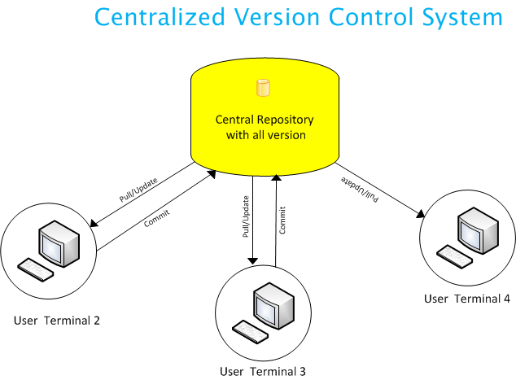

Slide 5
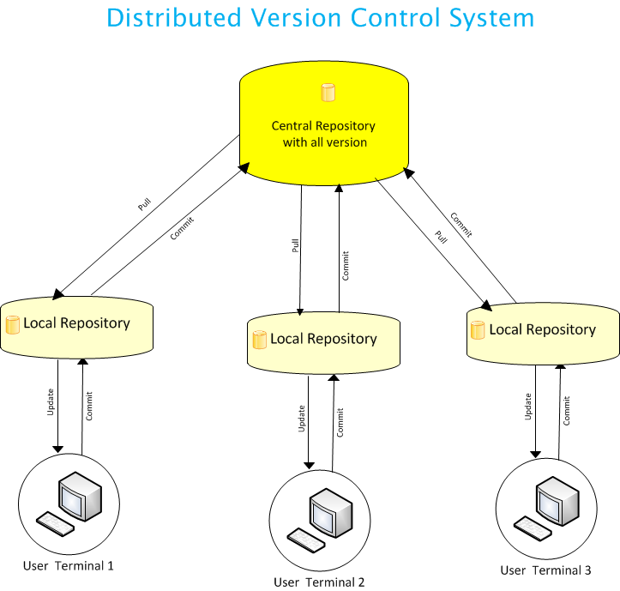

Slide 6
Centralized Vs. Distributed
One Repository | Multiple Repository
Offline not supported | Offline commit
Repository Recovery not Possible | Repository Recovery Possible
Mannual Merging | Automerging
 | Updation not possible without commit
SVN | Git, Mercurial

Slide 7
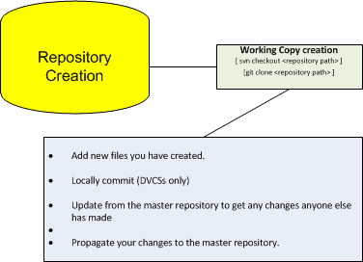
Workflow with VCS

Slide 8
Git & Github

Slide 9
Working with Git & Github
(Demostration Topics)
- Repository creation and uses
    - Branch Creation/Deletion
- Get latest code from repository and commit your code into local repository
- Merging/rebasing your branch into other
- Fixed conflict
- push your code into main repository
- Revert back your commit

Slide 10
THANK YOU

